Slide 1
Information Retrieval
Assignment 6 Algebric Models
Presented by: M. Umair Shahid [2021-CS-144]
Instructor: Dr. Khaldoon Syed Khurshid
Department of Computer Science University of Engineering and Technology Lahore

Slide 2
Introduction
Understanding Our Document Ranking Code
I’ve built a small program to rank documents based on how well they match a user’s query.
At the heart of this program is a basic neural network model.
The code processes text, converts it into numbers the model can understand, and then uses the network to produce a ranking of documents.

Slide 3

Goal Definition
Quickly find the most relevant documents from a large collection.
Instead of manually searching through hundreds of files, the system scores each document’s suitability for a query.
This leads to happier customers because they get more accurate results, faster.
By using a neural network, we aim to move beyond simple keyword matching to a smarter, learned approach.

Slide 4

Neural Network
Think of a neural network as a decision-making machine: it takes numbers in and gives a score out.
In our case, the “numbers in” represent how often certain important words (like “database” or “cloud”) appear in a document.
The network has simple layers of “neurons” that adjust how they weigh these words. Over time, it learns patterns that suggest a document might be more relevant.
Just as you might learn to guess what’s in a wrapped present by feeling its shape and weight, the network “feels” out which word patterns often match good answers.

Slide 5
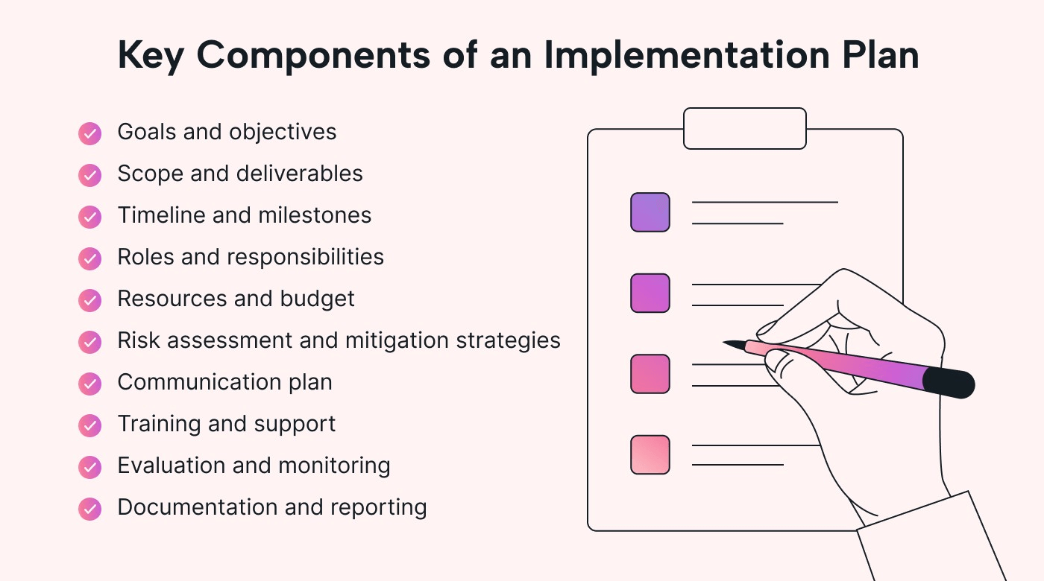
Implementation
Reading Documents: The code loads a batch of text files from a folder.
Extracting Useful Words: It identifies key nouns and builds a vocabulary.
Turning Words into Numbers: Each document becomes a list of counts—how many times each important word appears.
Neural Network Setup: We define a simple network with one hidden layer, initialized with small random values.
Training the Model: The code runs through these “word-count vectors,” adjusting the network’s weights so it can produce more meaningful scores over time.
Query and Ranking: When a query comes in, the code uses the trained network to score each document and present the top matches.

Slide 6
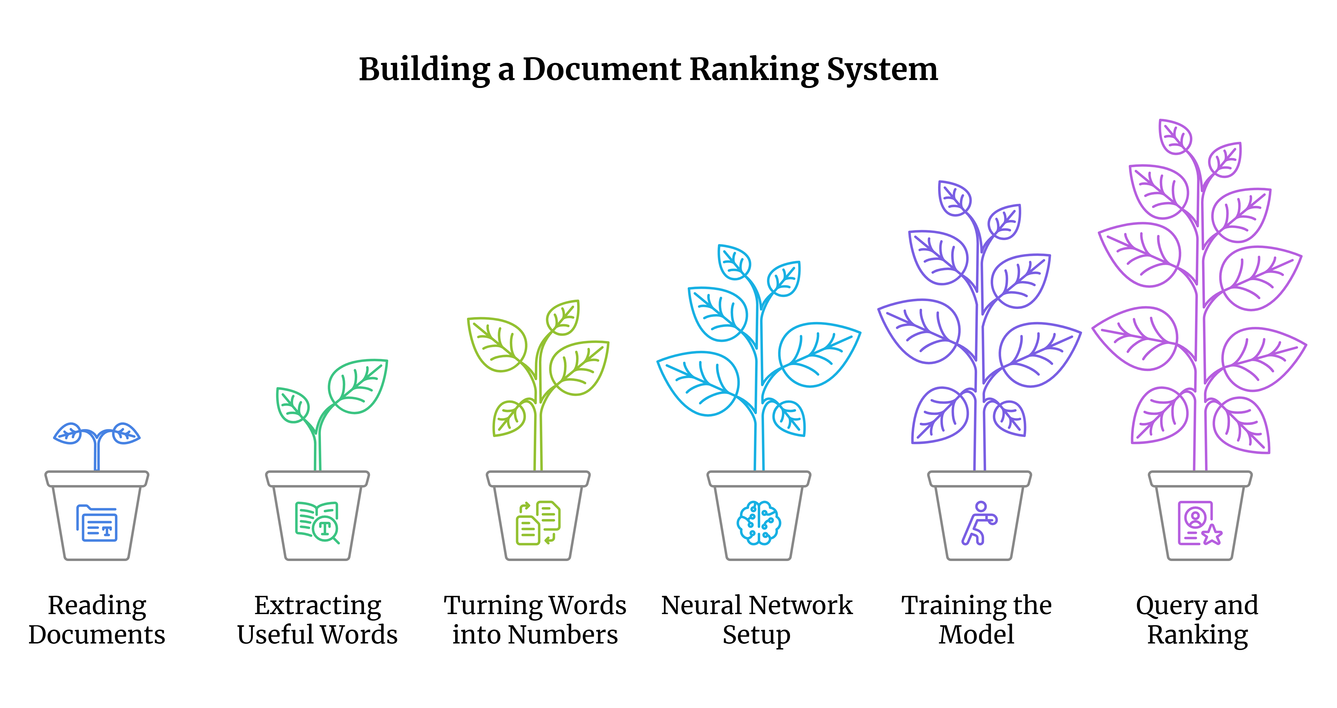
Implementation

Slide 7
Shortcomings
Use Real Relevance Data: Currently, the network is trained on random values. If we had true feedback—like which documents users find helpful—we could teach the model to rank documents more accurately.
Understand Context, Not Just Counts: Instead of just counting words, we could use advanced language models to grasp the meaning behind them.
Optimize Performance: For large datasets, we can speed up the process using more efficient data structures, vectorized operations (e.g., with NumPy), and possibly more advanced neural architectures.
Better User Feedback: Adding a mechanism where users can rate document results would help the network get smarter over time.

